Slide 1

Team Alpha
Joel Avery
Andrew Danielson
Bryan Moten
Amanda Peters

Slide 2

INTRODUCTION
The Alpha Team consists of:
Joel Avery is from Platte City, Missouri, is 32 years old, and lives with his wife and daughter with a boy on the way.
Andrew Danielson is from Boise, Idaho, but currently resides in Spangdahlem, Germany, working fulltime in the United States Air Force. He is 35 years old and lives with his wife, five children(4 boys and 1 girl) and Goldendoodle.
Bryan Moten is in Texas but currently resides in Spokane, Washington also serving in the United States Air Force. Bryan is a 28 year old married gentleman with 2 children.
Amanda Peters is currently pursuing her dream as a software developer, currently works as a manager at a beverage company and is moving into a developmental role.

Slide 3

OUTLAND ADVENTURES
The case study that was chosen was Outland Adventures. A few individuals opened a store up as a side job. They wanted to help other people with similar interests for the outdoors, fulfil their desires in far away places. They both quit their full-time careers to do this full time, and they believe with the right help, they can identify where the focus of their company needs to go. They are attempting to optimize the organization and that is where the alpha team comes in to assist.

Slide 4

Outland Adventures would like the following questions answered or to be able to track the metrics for
Do enough customers buy equipment, to keep equipment sales?
Out of the locations that they have done treks in such as Africa, Asia, and Southern Europe, are there any of these locations that have a downward trend in bookings?
They are curious and worried about some of the items in their inventory, and how long they have had them. They would like to track if they have any items over five years old.

Slide 5
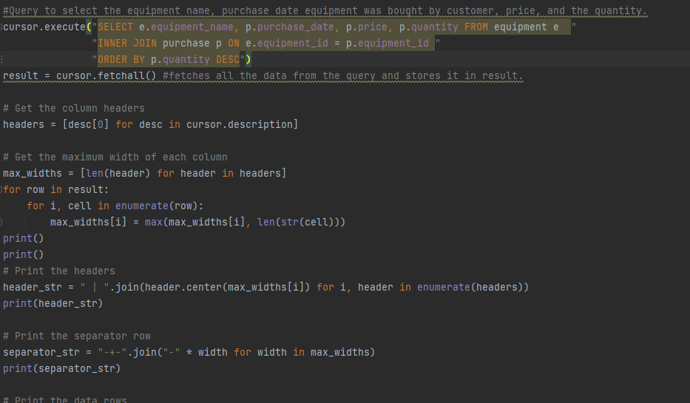
Do customers purchase enough equipment to warrant the retention of equipment sales?
This report looks at a few things again. First the question is do enough customers buy equipment to keep equipment sales.
The background of this slide is the actual code used to query the results of the equipment purchased, date, price, and quantity
For this report we select the equipment name from the equipment table, the purchase date, purchase price, and purchase quantity from the purchase table.
Results are then joined together by equipment id and output in a neatly laid out format and sorted by quantity most to least The customer can then decide what to do with the information.

Slide 6
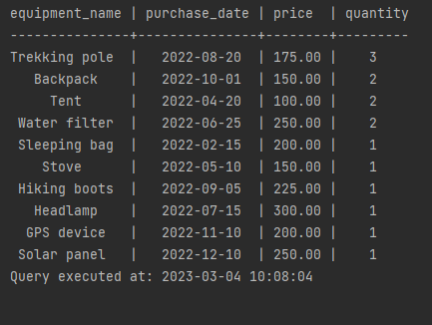
Retention of equipment sales-continued
The output from the code on the previous slide is located to the right.
The data is sorted by quantity, most to least.
We’re providing only the metrics from the data available.

Slide 7
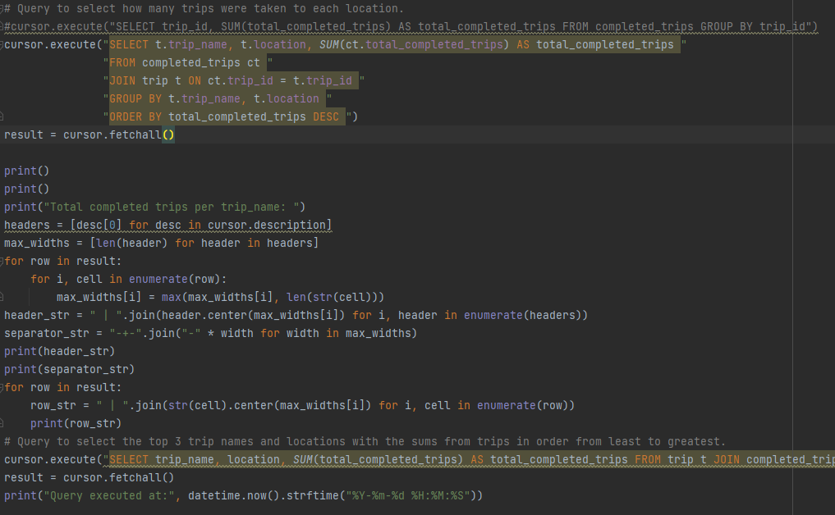
Do any of these locations have a downward trend in booking?
Once again, the background is the actual code for the query.
This report looks at a few things. First, we see how many trips were taken to each location. The name is “total_completed_trips” and is grouped by the “trip_id”.
We return the total number of trips for all booked travel destinations.
We then return the three lowest trips as total_completed_trips grouping by trip_id again

Slide 8
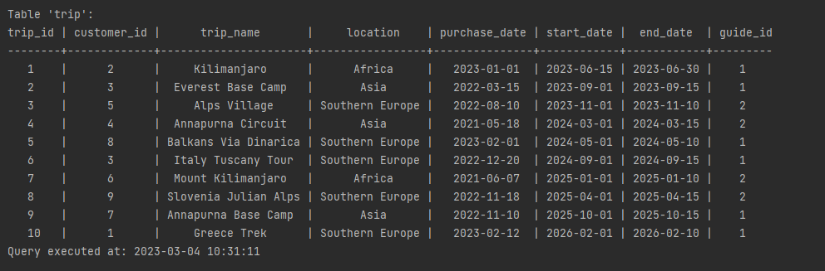
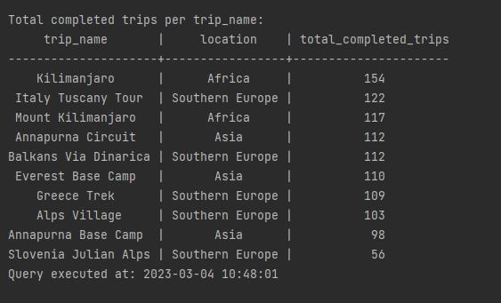
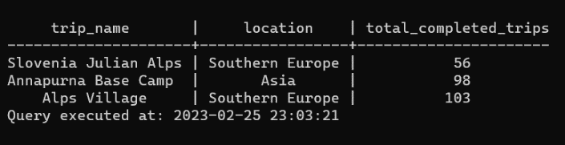
Trip Report’s
For this report, the main client concern is any downward trend in bookings for any destinations.
We report current bookings for scheduled future trips(top) for all the trips that have been booked.
We then report the all of the completed trips and group by “trip name” and “trip location” sorted by number of completed trips (middle)
We then report the three lowest booked trips and how many bookings there were, this can show them if it is like the other locations or if the number of bookings is far from the others. (bottom)
With all this data Outland Adventures can then decide the next steps needed.
Such as increasing awareness for the locations via various means or removing and replacing the low performing adventure.

Slide 9
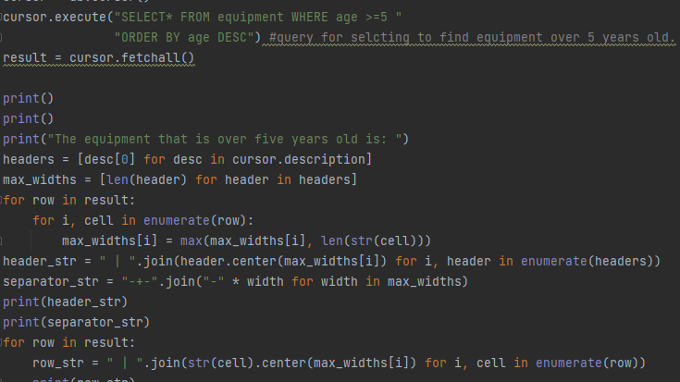
Age of Inventory
This report is relatively simple, we can pull with a query that shows how many items are in the store that are over five years old

Slide 10
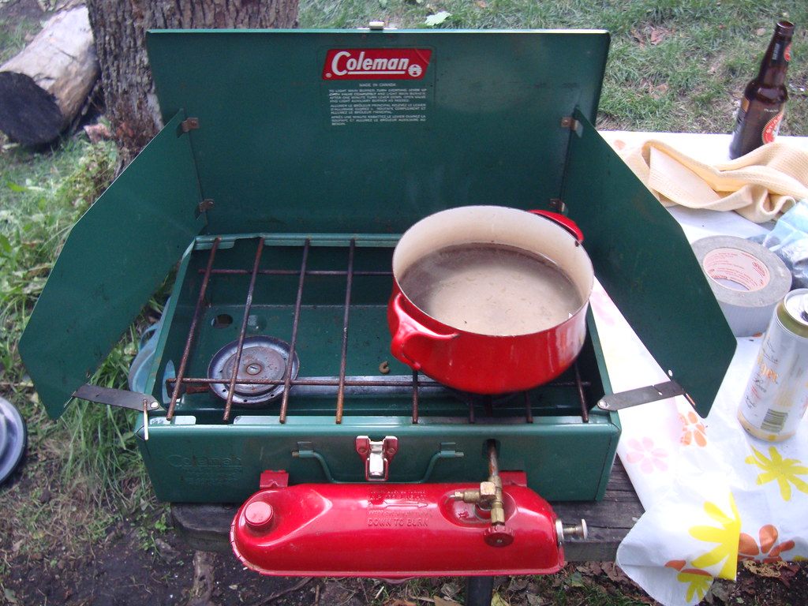
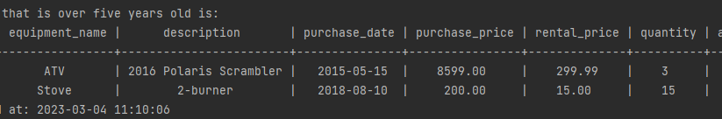
Age Of Inventory
The returned output below is from our query.
This query gives the output back of any of the equipment is greater than or equal to five years old.
The data is sorted with the age that is the highest at the top.
This Photo by Unknown Author is licensed under CC BY-SA

Slide 11
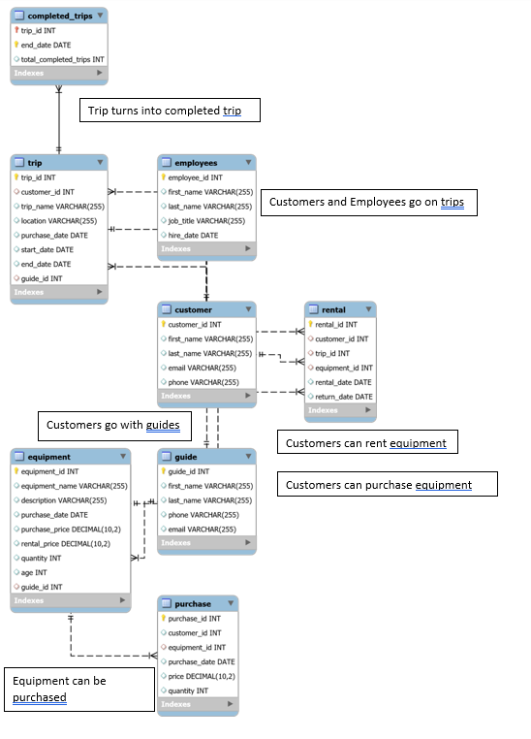
ERD Entity Relationship Diagram
An Entity Relationship (ER) Diagram is a type of flowchart that illustrates how “entities” such as people, objects or concepts relate to each other within a database or system.

